Slide 1

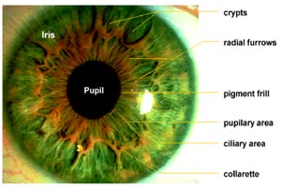
Iris Recognition
Rick Solotke Justin Parks

Slide 2
Overview
Problem Description
Research/Previous Work
Project Goals
Our Approach & Results
Challenges
Future Work
Lessons Learned

Slide 3
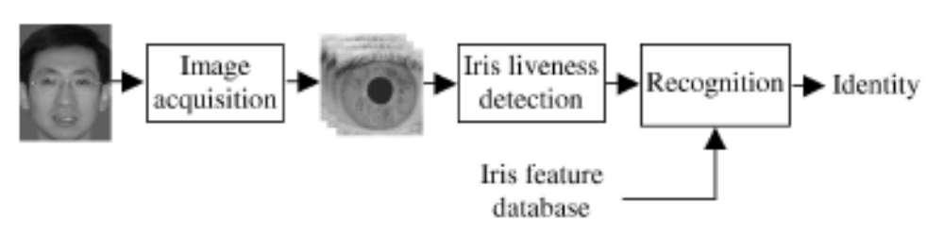
Problem Description
Biometrics
Identification
Hardware
Software

Slide 4
Research
Problem mostly solved
  Phase-based methods
  Zero-crossing representation methods
  Texture-analysis-based methods
Few public databases

Slide 5
Goals
Focus on iris processing (software only)
Obtain working area
Normalize
  Lighting
  Scaling
  Rotation
Feature extraction
Matching

Slide 6
Dataset
Michal Dobeš and Libor Machala, Iris Database, http://www.inf.upol.cz/iris/
3 x 64 left iris and 3 x 64 right iris images
24-bit RGB, 576 x 768 pixels, PNG
Captured by:
  TOPCON TRC50IA optical device
  SONY DXC-950P 3CCD camera

Slide 7
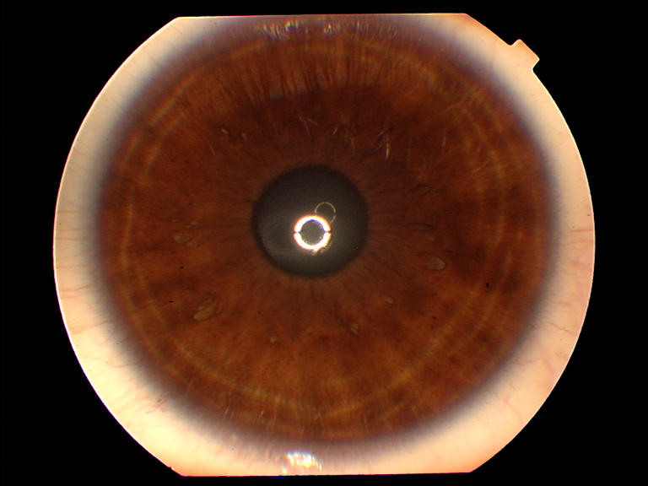
Dataset

Slide 8
Our Approach
Working Area
  Hough transforms
Normalizing Scale
  Map from Cartesian to Doubly Dimensionless Pseudo-polar Coordinate Space
Gabor Wavelet Features
Match via Hamming Distance

Slide 9
Obtaining the Working Area
Sobel edge operators
  Magnitude/Direction
Clean via thresholding/erosion
Obtain voters
Cast votes
Prune circles
Some domain knowledge

Slide 10
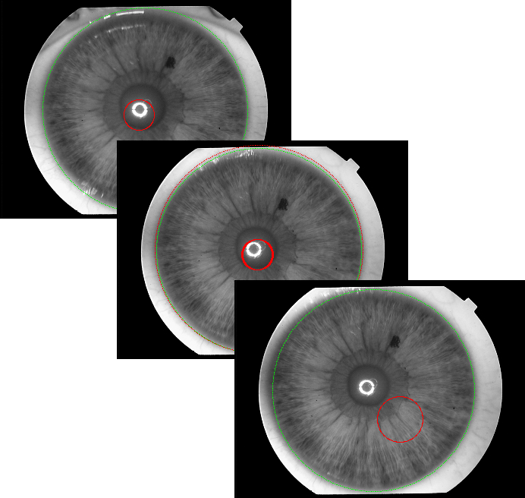
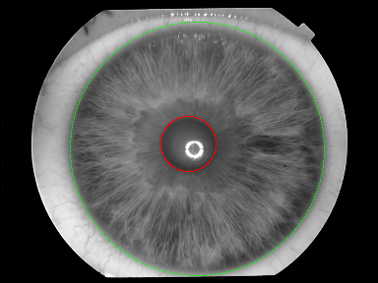
Hough Results

Slide 11
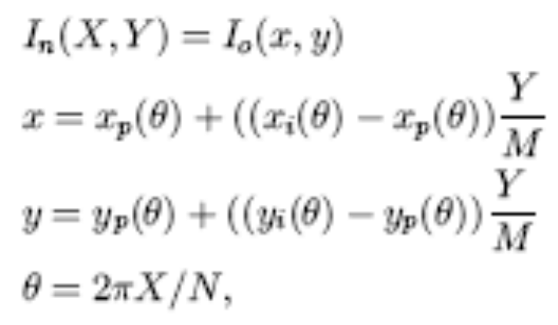
Scale Normalization
Map radial iris to rectangular form
Use iris/sclera and pupil/iris boundaries

Slide 12

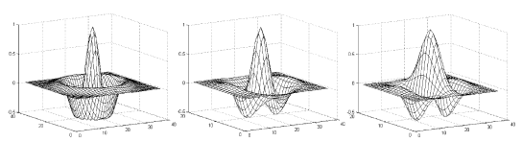
Gabor Wavelets
Identifies different frequencies of texture change using multiple filters

Slide 13
Matching
Nearest Neighbor Classifier
Hamming Distance
Threshold to ensure few false positives

Slide 14
Challenges
Picking the right circle
  Reflection in the pupil
  Boundary of image
  Iris not guaranteed to be circular
  Iris and pupil not guaranteed to be concentric
  Part of iris may be missing
Lighting normalization not complete

Slide 15
Enhancements
Lighting normalization
Rotation normalization
Contrast enhancement
Experiment with various wavelets
Experiment with matching thresholds
Other distance/matching methods
Deal with less processed/noisier input

Slide 16
Lessons
Get sick earlier
Research databases can be hard to obtain
Applied course work to research

Slide 17
Preguntas?

